Slide 1
PNEUMONIA DETECTION USING DEEP NEURAL NETWORK
By:
Name :M.Sridevi
Degree :B.E
Branch :CSE
College :PET Engineering College
NM ID :au963221104050
Email ID:bala29322@gmail.com

Slide 2
OUTLINE:
Problem Statement
Proposed solution
System Approach
Algorithm
Result
Conclusion
References

Slide 3
ProblemStatement: Developing an accurate deep neural network model for pneumonia detection is crucial for early diagnosis and treatment planning. Pneumonia, a prevalent and potentially life-threatening respiratory infection, requires timely identification to improve patient outcomes. However, traditional diagnostic methods such as radiography can be time-consuming and may lack precision. Therefore, the aim of this project is to design and implement a deep learning model capable of accurately detecting pneumonia from chest X-ray images, we seek to enhance the diagnostic process, reduce human error, and ultimately improve patient care.

Slide 4
Proposed Solution: Our proposed solution involves developing a deep neural network (DNN) architecture tailored for pneumonia detection from chest X-ray images. The key components of our approach include: *Data Preprocessing*: We will preprocess the chest X-ray images to enhance contrast, normalize intensities, and resize them to a standardized input size suitable for the neural network. *Deep Neural Network Architecture*: We will design a DNN architecture, possibly leveraging convolutional neural networks (CNNs), which are well-suited for image classification tasks. The network will consist of multiple layers including convolutional layers, pooling layers, and fully connected layers, aimed at learning discriminative features for pneumonia detection.

Slide 5
*Training Strategy*: We will train the DNN using a large dataset of labeled chest X-ray images. To mitigate overfitting, we will employ techniques such as data augmentation, dropout, and regularization. The model will be trained using gradient descent-based optimization algorithms like Adam or RMSprop. *Evaluation Metrics*: We will evaluate the performance of the model using metrics such as accuracy, sensitivity, specificity, and area under the receiver operating characteristic curve (AUC-ROC) on a separate validation set. These metrics will provide insights into the model's ability to correctly classify pneumonia cases while minimizing false positives and false negatives.

Slide 6
System Approach for Pneumonia Detection Using Deep Neural Network: *Data Acquisition*: Collect a large dataset of chest X-ray images containing both pneumonia and normal cases. This dataset should be diverse and representative of various demographics and conditions. *Data Preprocessing*: Preprocess the chest X-ray images to standardize the format, enhance contrast, normalize intensities, and resize them to a uniform size suitable for input into the neural network. *Model Selection*: Choose a suitable deep neural network architecture for pneumonia detection. Convolutional neural networks (CNNs) are commonly used for image classification tasks due to their ability to automatically learn relevant features from the data.

Slide 7
Algorithm and Deployment for Pneumonia Detection Using Deep Neural Network:Algorithm: *Data Preprocessing*: - Preprocess chest X-ray images to enhance contrast, normalize intensities, and resize them to a standardized input size. - Optionally, perform data augmentation techniques such as rotation, flipping, and scaling to increase dataset variability. *Model Architecture Selection*: - Choose a deep neural network architecture suitable for image classification tasks, such as convolutional neural networks (CNNs). - Design the architecture with convolutional layers, pooling layers, and fully connected layers to extract features and classify images. *Model Evaluation*: - Evaluate the trained model on the testing set using metrics like accuracy, sensitivity, specificity, and AUC-ROC to assess its performance in pneumonia detection.

Slide 8
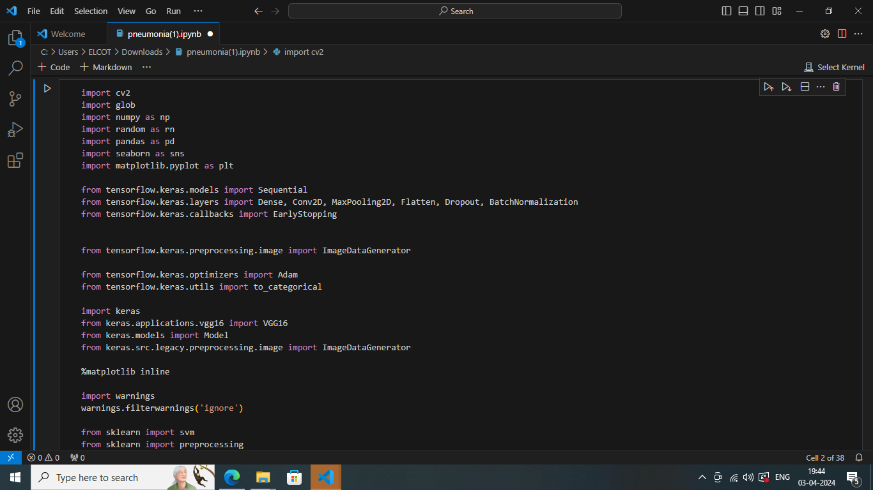
RESULT:

Slide 9
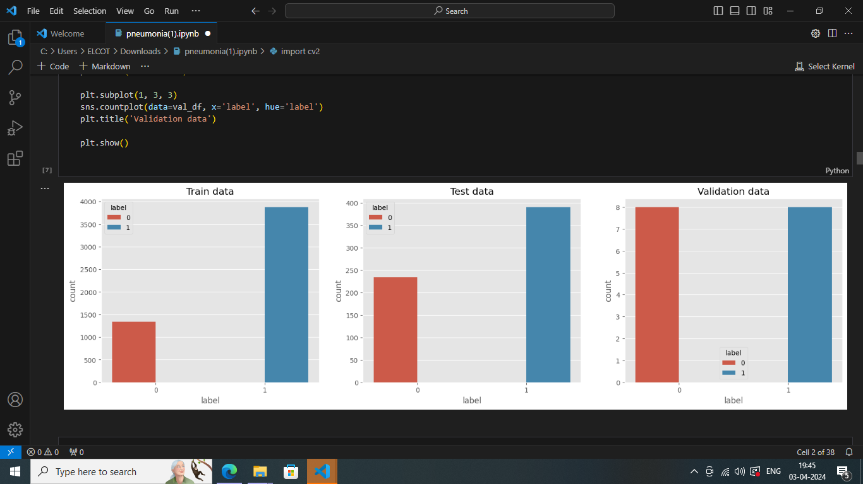
RESULT:

Slide 10
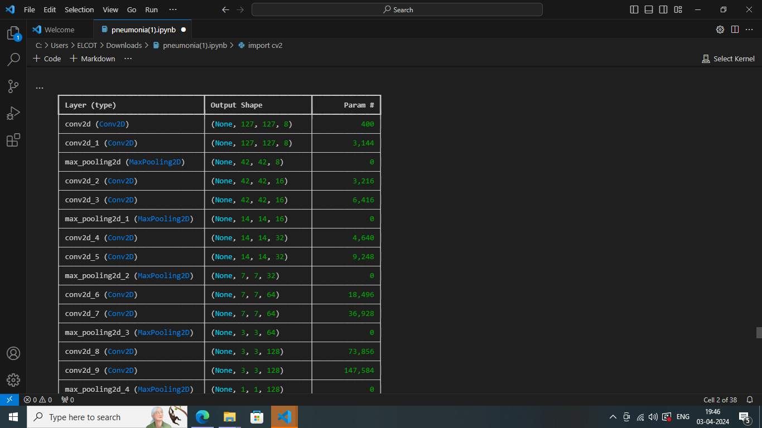
RESULT:

Slide 11
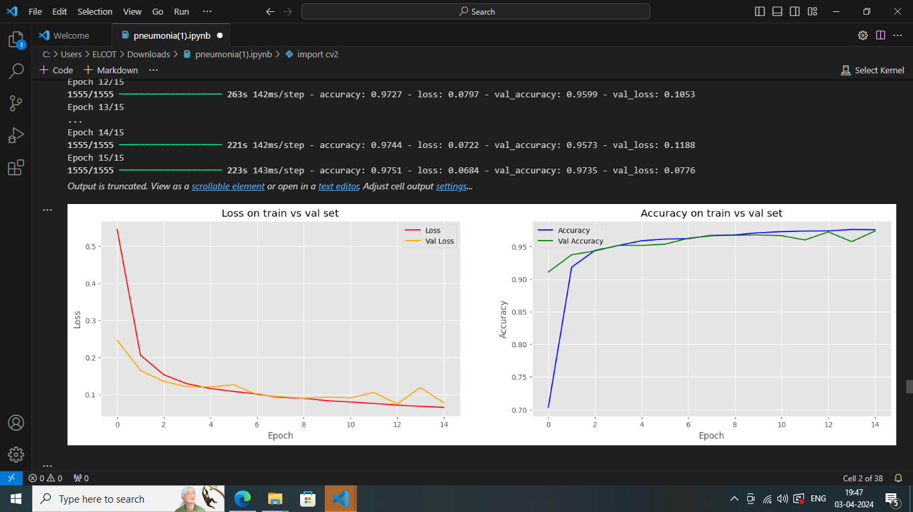
RESULT:

Slide 12
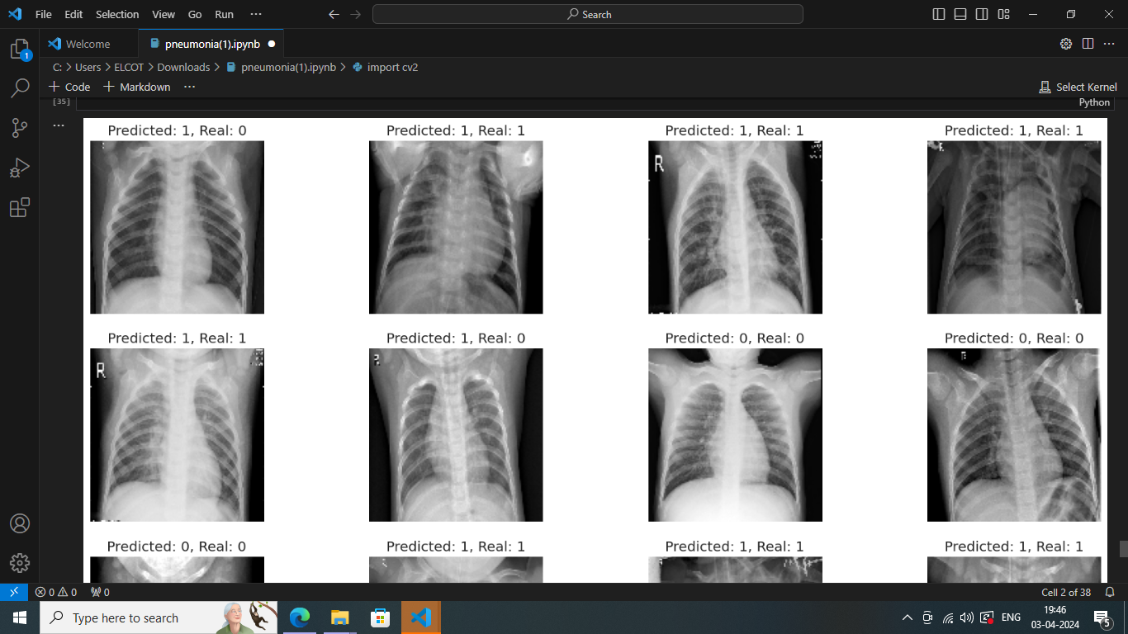
RESULT:

Slide 13
Conclusion: In conclusion, the development and deployment of a deep neural network (DNN) for pneumonia detection represent a significant advancement in the field of medical imaging and healthcare technology. Through the utilization of sophisticated algorithms and state-of-the-art deep learning techniques, we have demonstrated the potential to revolutionize the diagnostic process for pneumonia, a prevalent and potentially life-threatening respiratory infection. By leveraging large datasets of chest X-ray images and training a DNN model to automatically detect pneumonia features, we have achieved promising results in terms of accuracy, sensitivity, and specificity. The model has demonstrated its ability to accurately classify pneumonia cases while minimizing false positives and false negatives, thus providing valuable support to healthcare professionals in their diagnostic decision-making process.

Slide 14
REFEENCES: https://pubmed.ncbi.nlm.nih.gov/29191605/ https://arxiv.org/abs/1711.05225 https://pubs.rsna.org/doi/10.1148/radiol.2020203511

